Slide 1


.NET services in Istio
James Ekstrom

Slide 2
Outline
Demo
What is a service mesh
What is kubernetes
Motivation
Demo

Slide 3
Demo
Notes:
Show the initial setup, multiple services talking to each other to motivate why one would use Istio

Slide 4
Terminology
Data plane
Control plane
Sidecar
Pod
Container
Node
Envoy

Slide 5

Kubernetes
Orchestrate containers
Discoverability between services
Standardized networking and runtime protocols
Very active ecosystem and community

Slide 6
Service mesh
Provides abstraction over network objects
Layer 7 (application layer) functionality
Service to service communication
Easy to use metrics
Infrastructure as code
Standardized network configuration
Proxies
Notes:
routing = ingress, egress and between services

Slide 7
Why would I use a service mesh?
Transition into microservice architecture
Many services that need to communicate with each other
Deploy new features quickly
Do A/B testing
Gather metrics on services and connections

Slide 8
Examples of service meshes
Linkerd
Consul
Kong
Istio

Slide 9
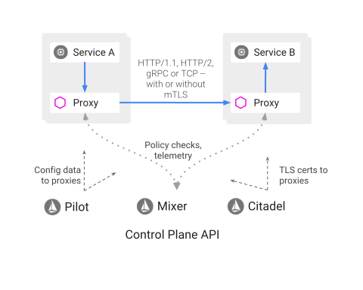
Istio
Proxy as sidecar for each pod
Routing
Load balancing
Fault tolerance rules
Rate limiting
Metrics
Security

Slide 10
Sidecar injection
$ kubectl label namespace default istio-injection=enabled
OR yaml:
apiVersion: v1
kind: Namespace
metadata:
labels:
istio-injection: enabled
name: default

Slide 11
Demo
Notes:
Show more advanced features now that we know more about Istio and Kubernets

Slide 12
Resources
istio.io
kubernetes.io
docker.com
dot.net
https://youtu.be/zJnYuFsLHfY (Istio - The Packet's-Eye View - Matt Turner, Tetrate)

Slide 13
Questions?

